Slide 1

VIDYA JYOTHI INSTITUTE OF TECHNOLOGY
Detecting Toxicity on Social Media: A Multi-task Learning Approach
Presented By:
Guide By : G Chancha Rao
VASAVI – 19911A12E5
KISHOR - 19911A12D0
VAMSHI - 19911A12C7
RAJESH - 19911A12E0

Slide 2
ABSTRACT
Offensive language is pervasive in social media. Individuals frequently take advantage of the perceived anonymity of computer-mediated communication, using this to engage in behavior that many of them would not consider in real life. Online communities, social media platforms, and technology companies have been investing heavily in ways to cope with offensive language to prevent abusive behavior in social media .
One of the most effective strategies for tackling this problem is to use computational methods to identify offense, aggression, and hate speech in user generated content (e.g. posts, comments, microblogs, etc.).. This system classifies a tweet as either offensive or not offensive (Sub-task A) and further classifies offensive tweets into categories (Sub-tasks B – C). Some sort of grid search approach is taken where multiple techniques for preprocessing, feature extraction and classification are implemented and combinations of them all are tried to achieve the best model for the given dataset .

Slide 3
EXISTING SYSTEM VS PROPOSED
In most of the existing systems, they do not perform hierarchical classification. In our model, we perform hierarchical classification by dividing the whole task into three individual sub-tasks i.e., sub-task A, sub-task B, sub-task C. We filter out the training data in every sub-task A, to improve accuracy and precision.
We did extensive data processing/ data analysis unlike in the existing systems. This was something that was missing in the existing systems. After doing the data analysis only we understood the imbalance in the data and ways to correct it.
All the existing models, do not perform oversampling and under sampling of the data. The accuracy and precision is reduced for those models due to unequal distribution of the data. In order to reduce the effect of the same, we did oversampling and under sampling of the data. We did oversampling and under sampling of the data in every sub task using SMOTE technique. We found out this to be quite advantageous.

Slide 4
EXISTING SYSTEM VS PROPOSED
We used both the Count and TF-IDF vectorizers unlike in the existing systems. We did not use one single model like in the existing systems. We have used a bunch of models i.e., Logistic Regression, SVM, Naive Bayes, and Random Forest classifier for each of the sub-task to see what would work the best.
We did extensive error analysis unlike the existing systems/models which gives us an extra edge. We found out that all classifiers find it difficult to identify offensive tweets that lack profanity.
For example, tweets such as “@USER Get back on your peanut farm old man” were not classified as offensive tweets at all. Infact, the tweet (49813) “@USER She is such a witch. All she needs is a broom” was also not classified as offensive since they lack profanity/ swear or offensive words. We also analyzed that all the classifiers we trained our models weren’t effective in classifying political discussion since it learned trends of the words such as ”Trump”. Performing error analysis gives us an extra edge over all the existing systems since it gives us idea on what to improve in the future.

Slide 5
PROPOSED PROJECT OBJECTIVES
The main objective of the project is to classify the tweets into two main categories
i.e offensive or not offensive tweets and further classify offensive tweets into individual groups, in which offensive tweets are classified to targeted or untargeted insult and further targeted insult is classified to different groups based on target of the tweet such as individual , group , others .
Using machine learning models we can categorize the tweet into offensive or not offensive(task 1),targeted or untargeted insult(task 2),group or individual offensive target identification(Task 3).
We can use different kinds of models for classifying the data Naive Bayes, SVM, Random Forest, Logistic Regression.

Slide 6
PROPOSED PROJECT OUTCOMES
We trained our dataset using the aforementioned models in all the subtasks.
In subtask A, we found that using the original dataset, the Naive Bayes model, and Count Vectorizer - we got the accuracy of the model as 74.74. Next, we trained our model using SVM using the original dataset and TFIDF vectorizer. We obtained the accuracy as 74.49. On using the Count vectorizer, the accuracy reduced to 74.13 .
For subtask B, on training our model with the Logistic Regression, Original Dataset, and Count Vectorizer we obtained an accuracy of 88.18 and the F1 score as 0.53. Logistic Regression performed the best for subtask B. We also trained using Naive Bayes on the original dataset using Count vectorizer and obtained the accuracy as
86.9 and the F1 score as 0.49 . We got the accuracy as 84.72 on using the Random Forest Model on the oversampled data, using TF-IDF vectorizer for feature extraction. Naive Bayes came very close to Logistic Regression in terms of accuracy for this subtask.
For subtask C, the training dataset was quite small. We were expecting the accuracy to be quite low. We found that the Naive Bayes model performed the best here. We trained using the original dataset and the feature extraction method was Count Vectorizer. We got the accuracy as 69.83..

Slide 7
SOFTWARE AND HARDWARE REQUIREMENTS
Software requirements :
Operating System(OS) Windows 7/Windows 8/Windows 10/Ubuntu
REQUIRED PACKAGES :
NumPy : used for quicker numerical calculations and is helpful for manipulations on multidimensional arrays.
Pandas: used to perform data analysis and machine learning tasks.
Matplotlib : It is a python library used for visualizations and graphical plotting. Scikit-learn : It makes the machine learning tasks easy to implement by providing the inbuilt methods for every ML algorithm such as decision trees, random forest etc.
Hardware requirements:
Laptop/ Personal Computer (PC)
Internet
Processor: 1.7 GHz Processor and above
Random Access Memory (RAM): 1 GB ,Hard disk:2GB

Slide 8
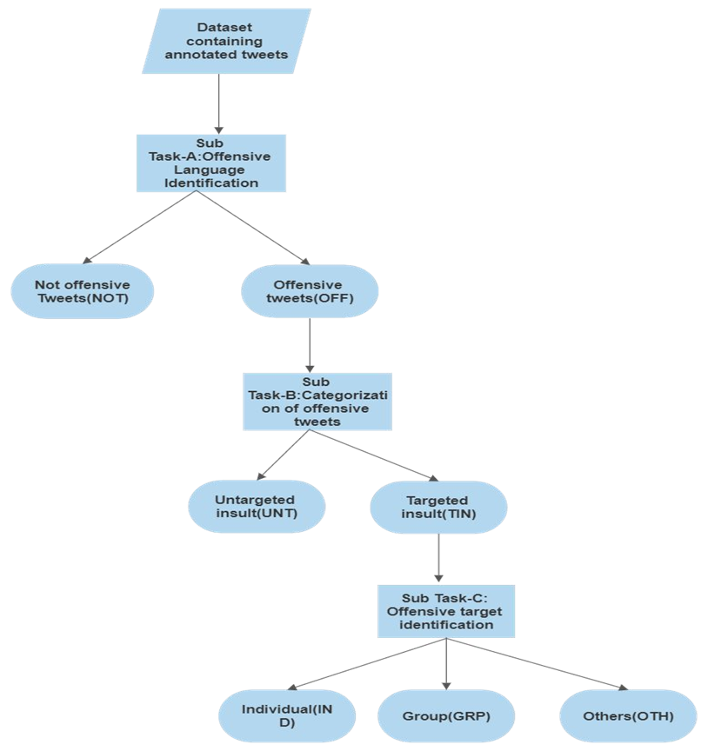
ARCHITECTURAL DIAGRAM

Slide 9
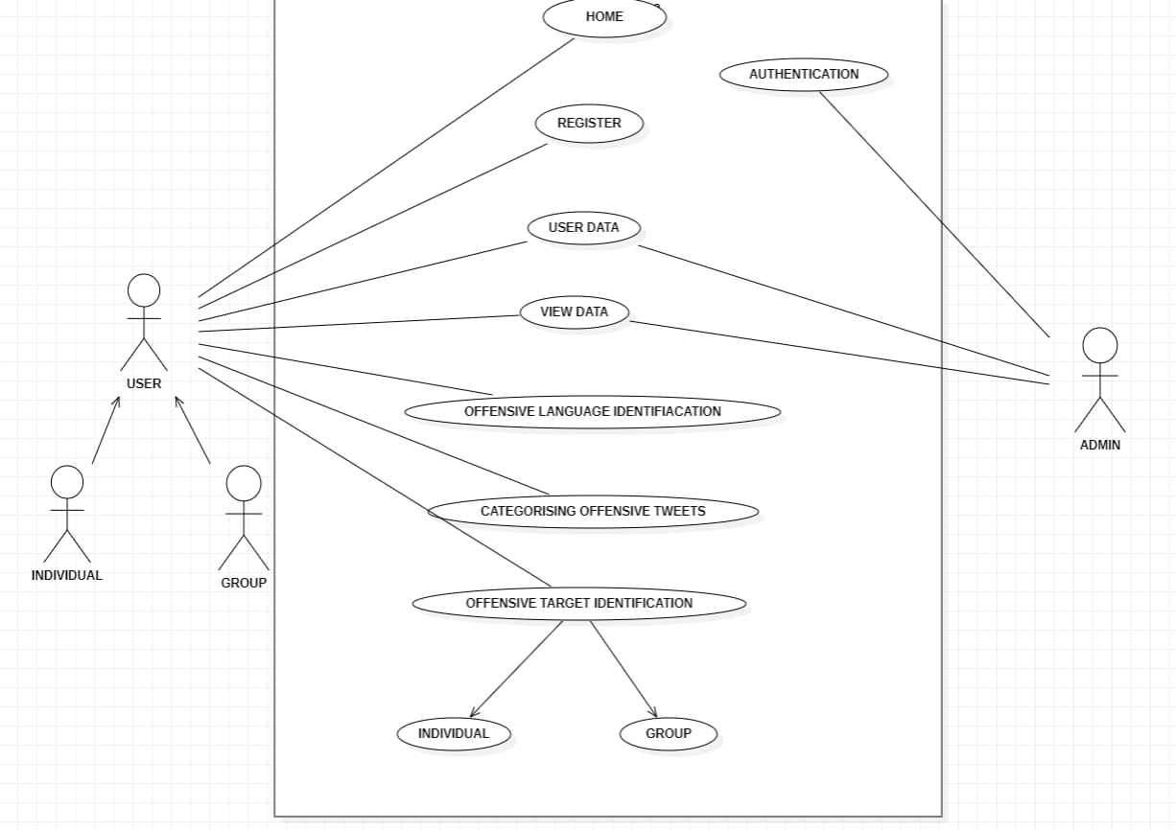
Use Case Diagram

Slide 10
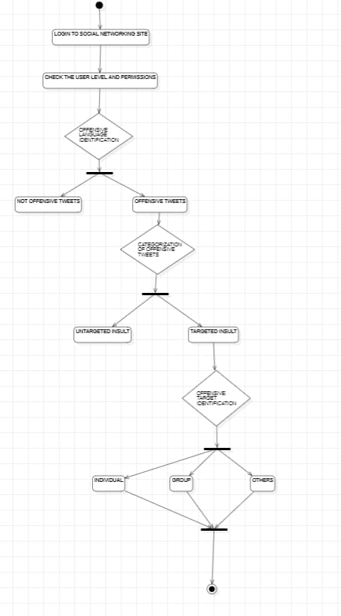
Activity Diagram

Slide 11
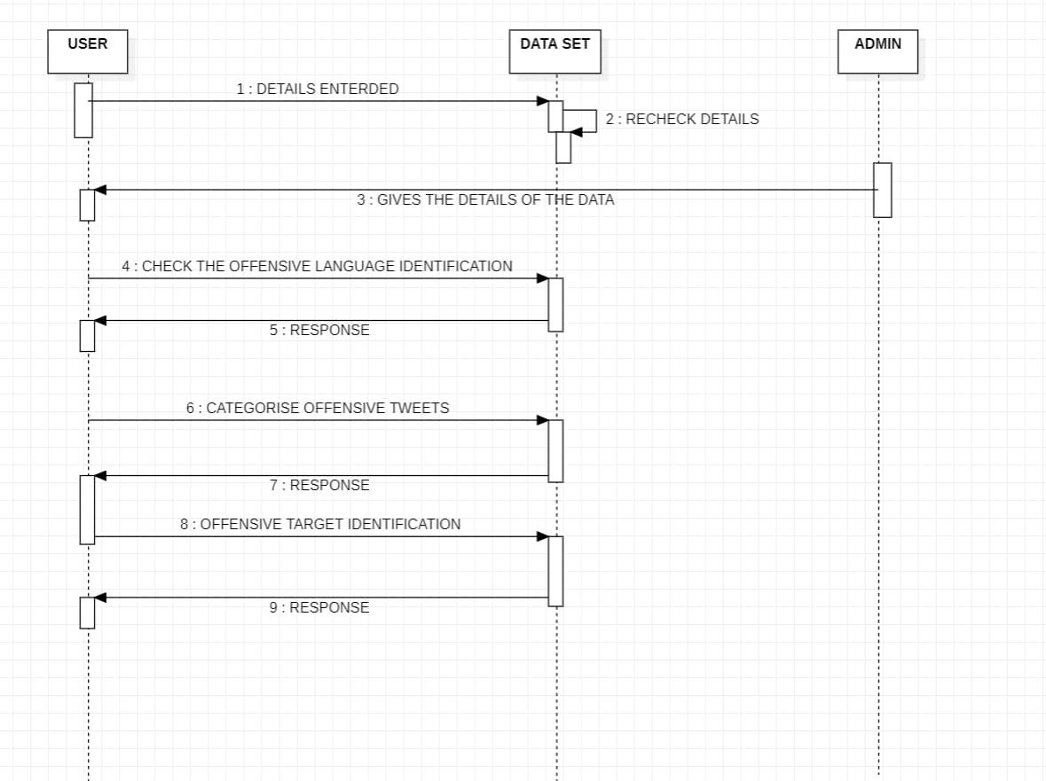
Sequence DIAGRAM

Slide 12
PROPOSED METHODS AND ALGORITHMS
Logistic Regression
Regression is used to know the relationship between independent variables and dependent variables.
Logistic regression is a regression technique used to predict a binary labeled data based on the prior experience gained by training dataset.
It is used when the prediction has only 2 outputs such as yes/no,true/false,0/1 etc.
In Sub task-A we have two outcomes of the tweet which is either offensive tweet(OFF) or not offensive tweet(NOT).
Similarly for Sub task-B we have two outcomes either targeted insult(TIN) or untargeted insult(UNT).
It is a statistical analysis used for prediction.

Slide 13
PROPOSED METHODS AND ALGORITHMS
Random Forest Classifier
The detailed steps involved in random forest classifier are as follows: i.Select k data points from training set randomly.
For each of the selected data point which is a subset build a decision tree. iii.Finalize the value of n.Here n denotes number of decision trees to be built. iv.Repeat step-i and step-ii.
For new data points/instances of testing dataset find the predictions of each decision tree.
By calculating the majority of predictions finalize the output/label of the instance.

Slide 14
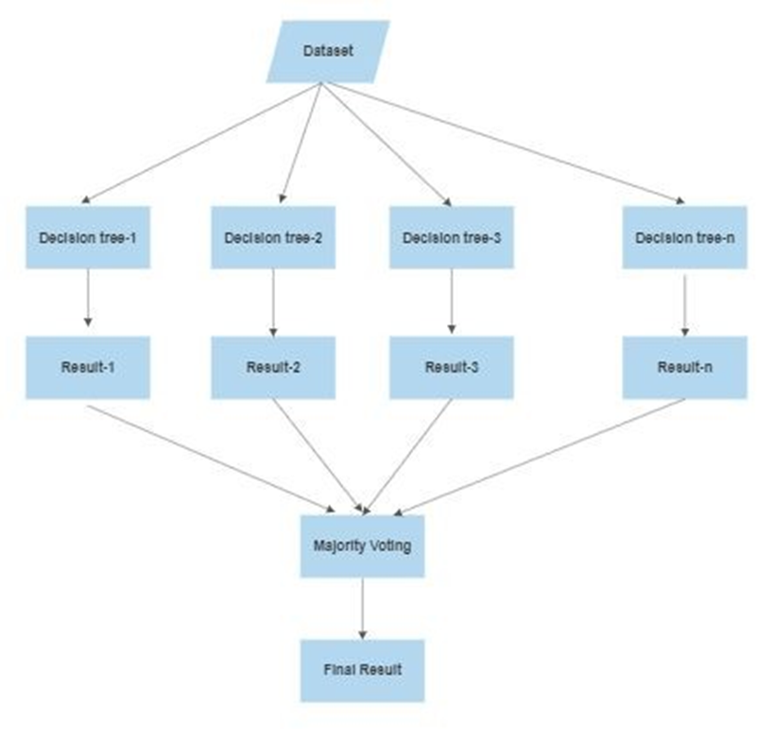
PROPOSED METHODS AND ALGORITHMS
Working process of Random Forest Classifier :

Slide 15
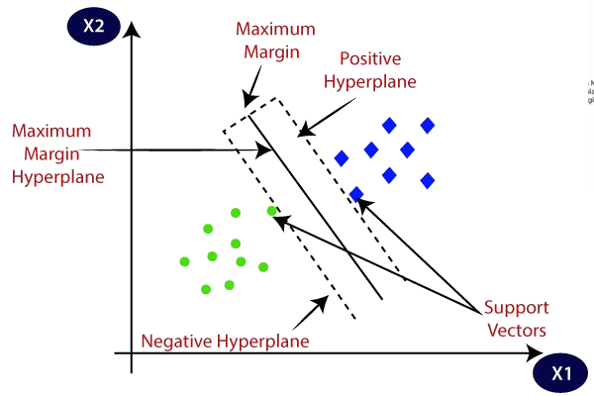
PROPOSED METHODS AND ALGORITHMS
Support Vector Machine(SVM)
The working of SVM classifier is as follows:
We plot an n-dimensional space for each data item where n represents number of features.Here data item is represented as a point.
Every coordinate is represented by the value of feature.
The next step is to find the hyperplane which differentiates the two classes. For example in sub task -A there are two classes OFF(offensive) and NOT(not offensive).Classification of tweets in every sub task is done by finding a suitable hyperplane which separates both the classes.
The best hyperplane is found such that the plane has maximum margin which means it has maximum distance from both the classes.Points that fall on the either side of plane can be grouped as different classes.

Slide 16
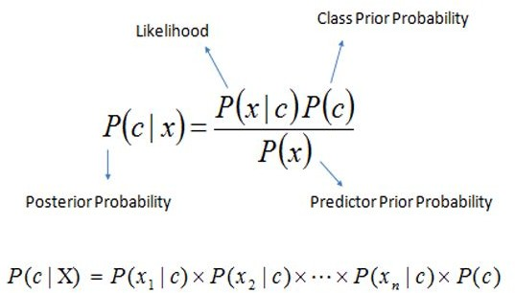
PROPOSED METHODS AND ALGORITHMS
Naive Bayes Classifier
Naive bayes classifier is easy to build algorithm which is based on bayes theorem.It is used for building fast machine learning models which make quicker predictions.The main assumption to work with naive bayes classifier is that every pair of features being classified is independent of each other. It is also called as probabilistic classifier as it calculates the probability for prediction.Naive bayes classifier is mainly used for text classification which contain very large datasets.
Naive bayes algorithm is suitable in filtering spam mails and categorizing articles. We used the Naive Bayes classifier for multinomial models provided by sklearn with default parameters.For text classification it is better to
use Multinomial Naive Bayes Classifier.

Slide 17
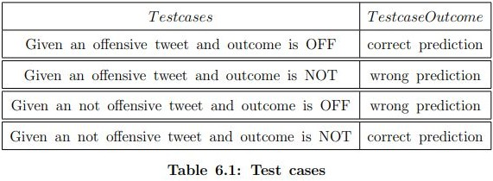
TEST CASES
Determining possible test cases for sub task-A

Slide 18
TEST CASES
Examples of tweets :
For Sub Task-A:
”@USER was literally just talking about this lol all mass shootings like that have been set ups. it’s propaganda used to divide us on major issues like gun control and terrorism” – OFF (Offensive tweet).
”@USER Buy more icecream!!!” – NOT (Not offensive tweet) For Sub task-B:
”@USER Liberals are all Kookoo !!!” – OFF (Offensive tweet) , TIN (Targeted insult).
”@USER yea your the bitch on the right getting smacked URL” – OFF (Offensive tweet) , UNT (Untargeted insult).
For Sub task-C:
”@USER you are a lying corrupt traitor!!! Nobody wants to hear anymore of your lies!!! DeepStateCorruption URL” – OFF (Offensive tweet) , TIN (Targeted insult) , IND (Individual).
”@USER was literally just talking about this lol all mass shootings like that have been set ups. it’s propaganda used to divide us on major issues like gun control and terrorism” – OFF (Offensive tweet) , TIN (Targeted insult) , GRP(Group).
”@USER Liberals are all Kookoo !!!” – OFF (Offensive tweet) , TIN (Targeted insult) , OTH (Others).

Slide 19
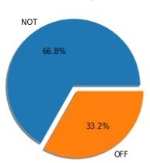

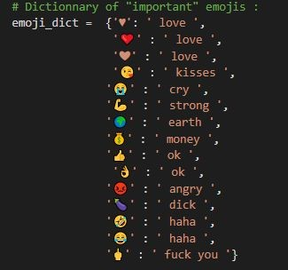
OUTPUT SCREENS
Distribution of tweets(Data Exploration and Analysis)

Slide 20
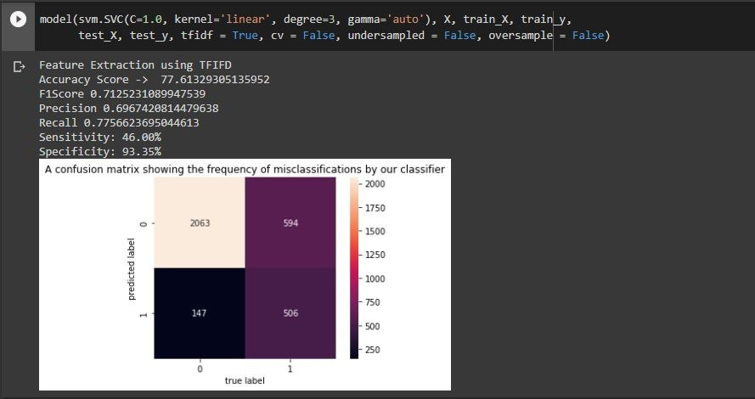
OUTPUT SCREENS
Confusion Matrix for highest accuracy of Subtask-A

Slide 21
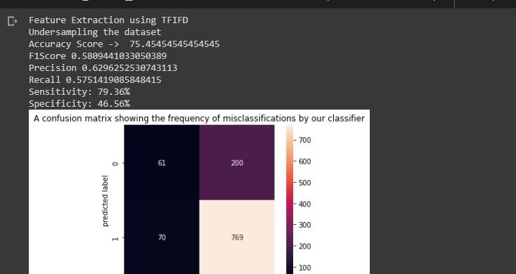
OUTPUT SCREENS
Confusion Matrix for highest accuracy of Subtask-B

Slide 22
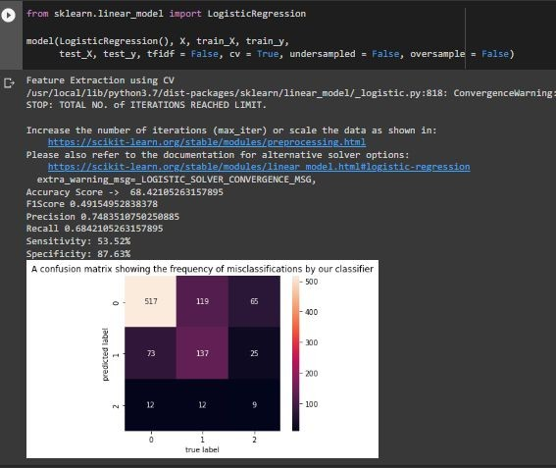
OUTPUT SCREENS
Confusion Matrix for highest accuracy of Subtask-C

Slide 23
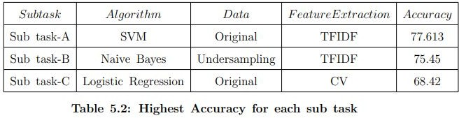
RESULT ANALYSIS
Highest Accuracy for each sub task :

Slide 24
CONCLUSION
In this project,we were able to classify offensive and not offensive tweets of the testing dataset using different machine learning techniques(Task-1), identify the categories of offensive tweets(Task-2) and further classify targeted tweets for target identification(Task-3).
The various machine learning algorithms used for classification are: Naive Bayes,Random Forest,Logistic Regression,Support Vector Machine.
We have also done the data exploration and analysis which helped us to understand the dataset.Data preprocessing is also an important step which include replacing emojis with relevant meaning,splitting the tweet into words/tokens and removing of unuseful words. Count and TFIDF vectorization techniques are used in Feature extraction.As the dataset was imbalanced we also tried to implement undersampling and oversampling techniques.

Slide 25
FUTURE SCOPE
In the future we plan to extend our project by using different deep learning models like CNN and LSTM.CNN stands for Convolution Neural Network.LSTM stands for Long Short Term Memory Network. TextCNN is a method used for text classification. As input to the model implemented is a dataset containing tweets which is in form of text.These deep learning models can perform better for text classification.
As the content generated on various social media platforms can be in either a text/image.So we can extend our project by taking posts/images for offensive content classification which requires image classification techniques.
We also plan to make use of ensemble model. Ensemble models by definition mean averaging the output obtained in order to increase accuracy and precision. We learned that the state of the art BERT system works really well in these cases and hence plan to implement using that.

Slide 26
REFERENCES
Ehsan Doostmohammadi, Hossein Sameti, and Ali Saffar. “Ghmerti at SemEval-2019 task 6: a deep word-and character-based approach to offensive language identification”. In: arXiv preprint arXiv:2009.10792 (2020).
Avishek Garain and Arpan Basu. “The titans at semeval-2019 task 6: Offensive language identification, categorization and target identification”. In: Proceedings of the 13th International Workshop on Semantic Evaluation. 2019, pp. 759–762.
Piush Aggarwal, Tobias Horsmann, Michael Wojatzki, and Torsten Zesch.
“LTL-UDE at SemEval-2019 Task 6: BERT and two-vote classification for categorizing offensiveness”. In: Proceedings of the 13th International Workshop on Semantic Evaluation. 2019, pp. 678–682.
Himanshu Bansal, Daniel Nagel, and Anita Soloveva. “HAD-T¨ubingen at SemEval-2019 Task 6: Deep learning analysis of offensive language on Twitter: Identification and categorization”. In: Proceedings of the 13th International Workshop on Semantic Evaluation. 2019, pp. 622–627.
Segun Taofeek Aroyehun and Alexander Gelbukh. “Aggression detection in social media: Using deep neural networks, data augmentation, and pseudo labeling”. In: Proceedings of the First Workshop on Trolling, Aggression and Cyberbullying (TRAC-2018). 2018, pp. 90–97.

Slide 27
Thank You

